Slide 1


GLOBAL FACEBOOK
USAGE ANALYSIS
AN EXPLORATION OF FACEBOOK USER TRENDS
Presented by Camila Hernandez
COP 2073 - Foundations of Data Analytics

Slide 2
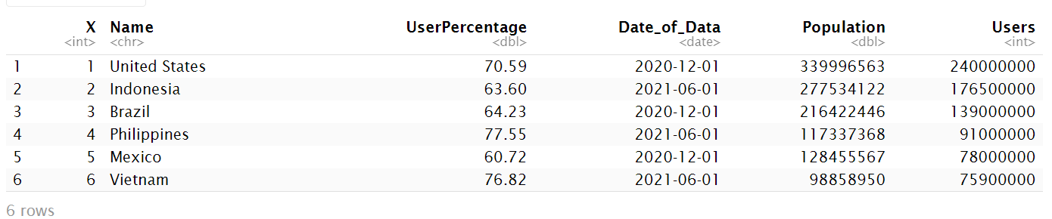
ABOUT THE DATA
Data Columns
  Name: This column contains the names of 126 different countries
  Facebook_Users: Number of Facebook users in each country
  UserPercentage: Percentage of the population using Facebook
  Date_of_Data: Date when data was collected
  Population: Total population of each country
Data Cleaning:
  Removed M/K from Users
  Removed % from UserPercentage
  Cleaned Population (no commas)
  Added a Continent column

Slide 3
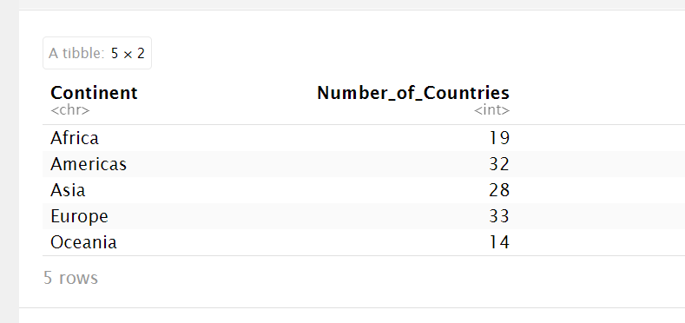
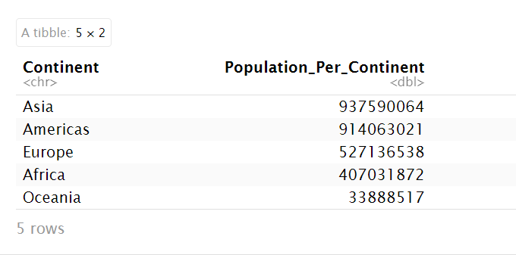
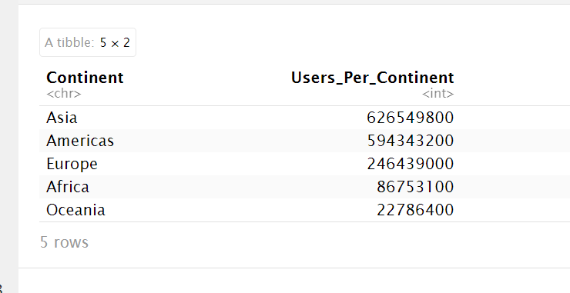
SUMMARY STATS

Slide 4

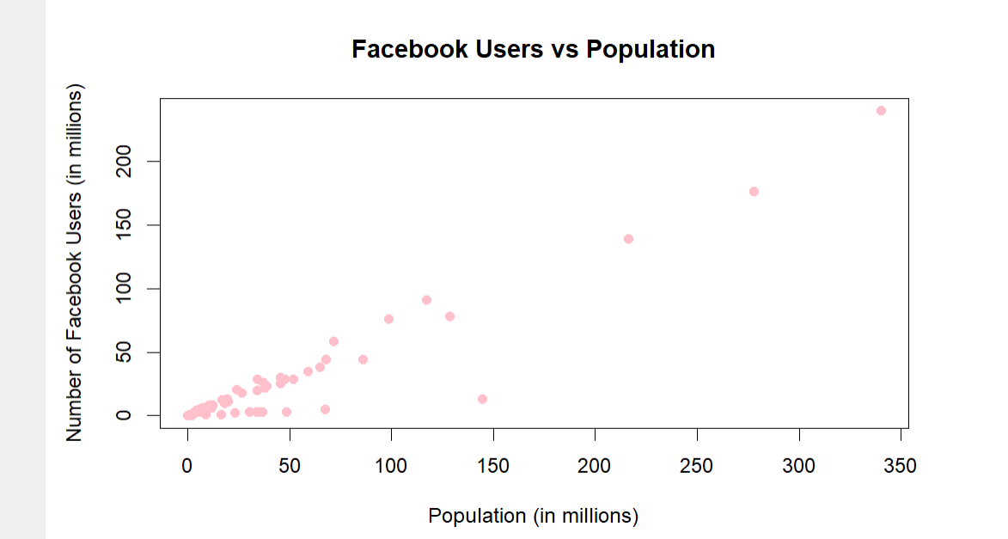
SCATTERPLOTS
  Positive trend: countries with larger populations generally have more Users
  Outliers can be seen around 25–50 million population, ex., Russia has fewer users than expected
  These outliers do not follow the trend seenin most countries
In this graph we compare the number of Facebook users to the population of these countries.

Slide 5
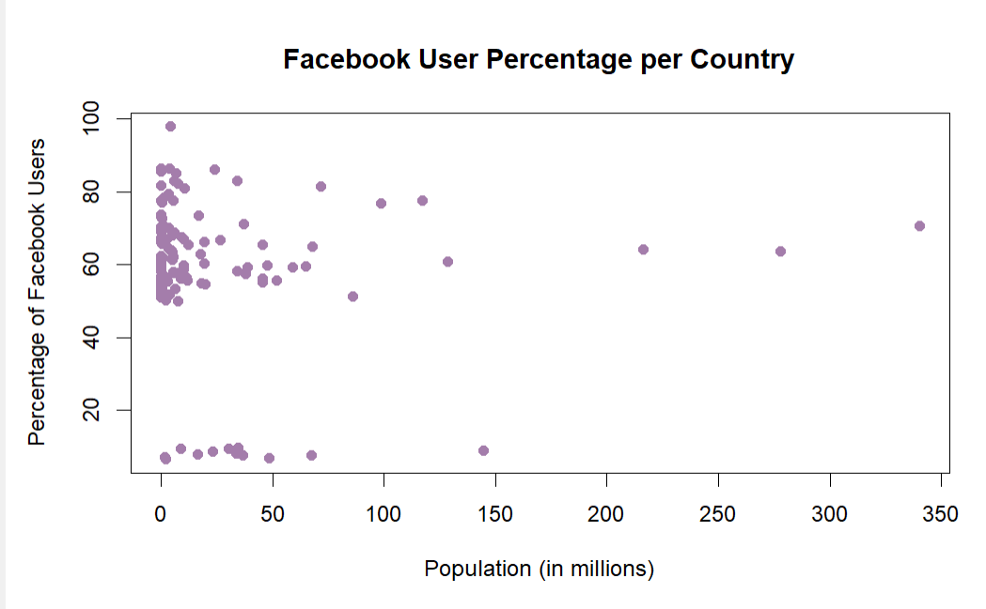
SCATTERPLOTS
  No clear positive or negative trend between population and user percentage
  Most countries create a cluster around 50–80% Facebook users
  Country size alone does not determine Facebook user percentage
  Possible factors for outliers: internet penetration, other social media platforms, cultural preferences
This graph compares the percentage of Facebook users in countries of different population sizes.

Slide 6
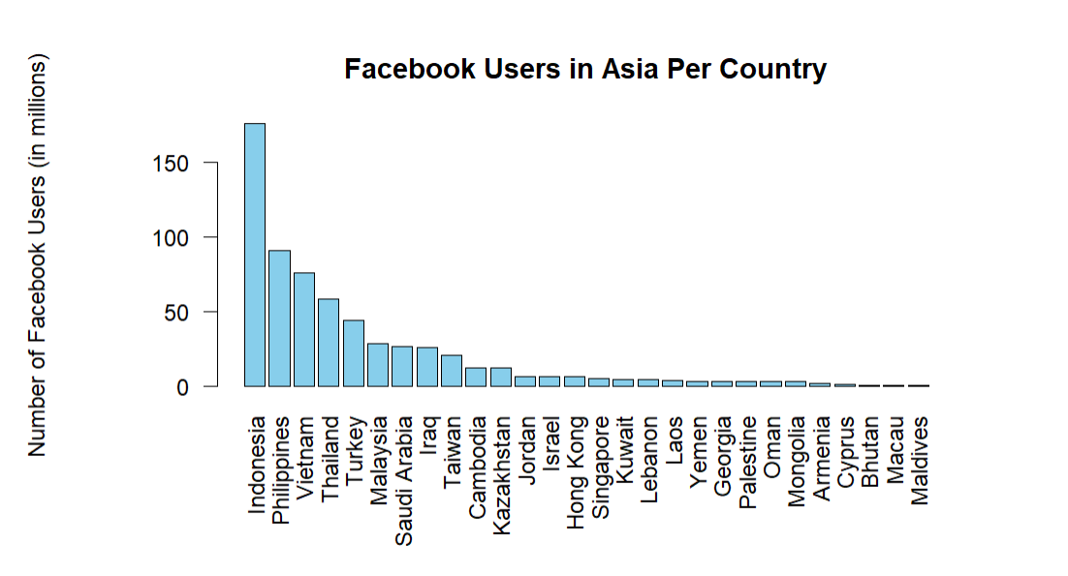
DATA BY CONTINENTS
ASIA
Indonesia has the highest number of Facebook users, followed by the Philippines and Vietnam.

Slide 7
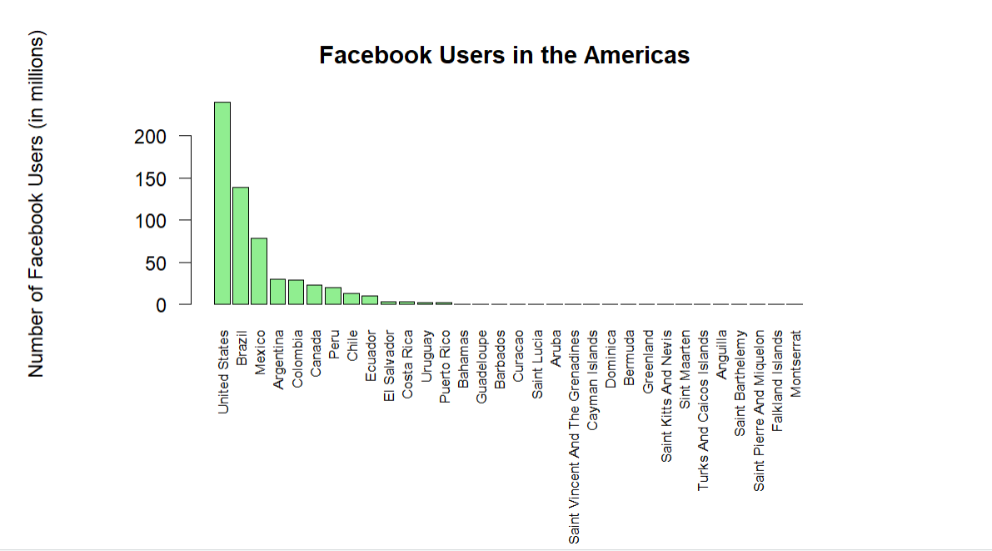
DATA BY CONTINENTS
AMERICAS
The United States has the highest number of users, followed by Brazil and Mexico.

Slide 8
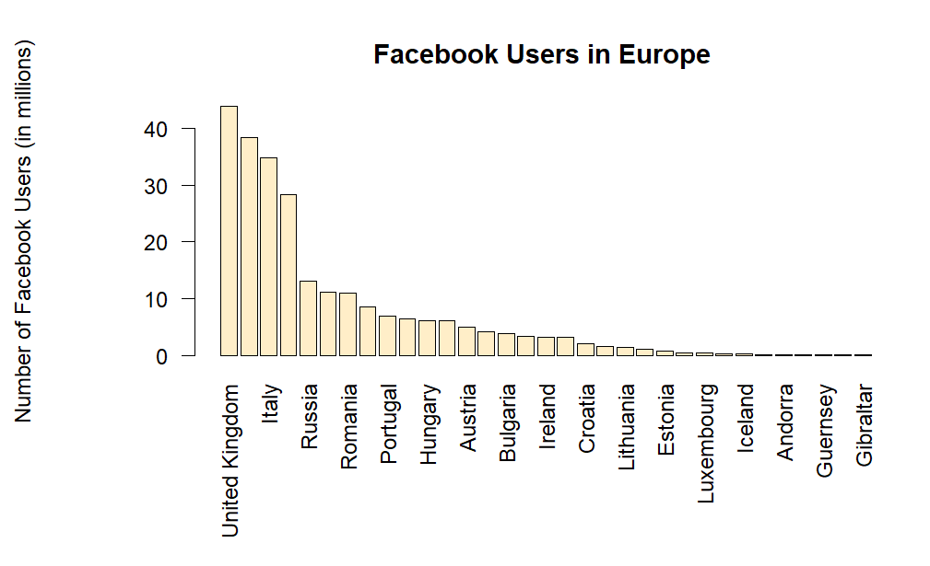
DATA BY CONTINENTS
EUROPE
The United Kingdom, Italy, and Romania have the highest user counts in Europe.

Slide 9
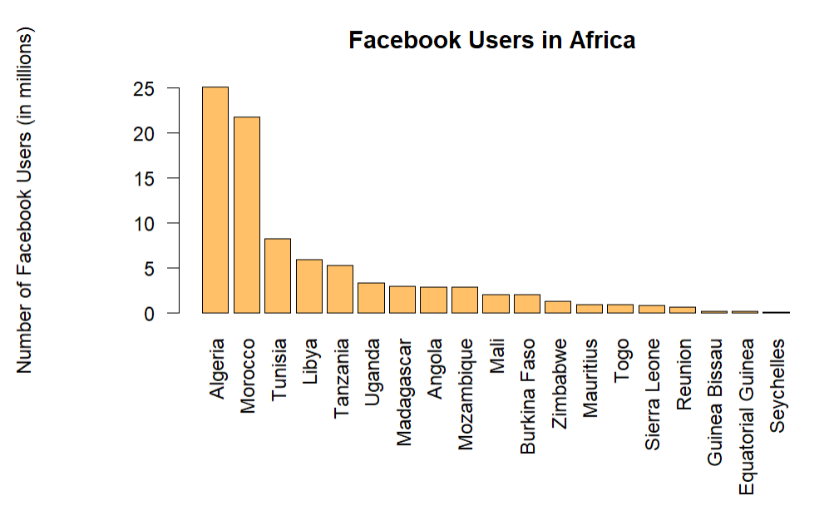
DATA BY CONTINENTS
AFRICA
Algeria and Morocco stand out with the largest user count.

Slide 10
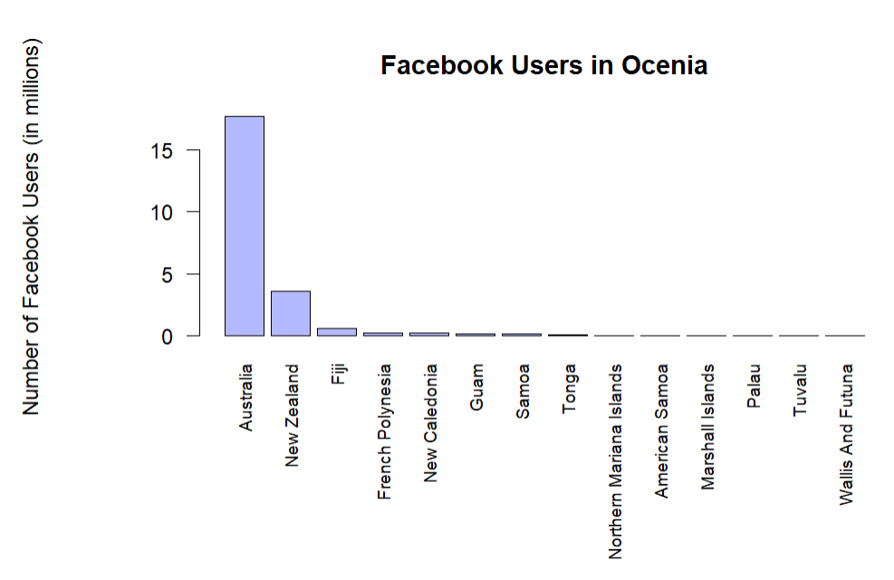
DATA BY CONTINENTS
OCENIA
Australia has the largest number of users by far, with other countries like New Zealand and Fiji behind.

Slide 11
RESULST
  Number of users increases with population, with outliers like Russia
  User percentage does not have a direct correlation with population, most countries cluster 50–80%
  Population alone does not determine Facebook usage percentage
  Outliers suggest other factors affect usage
Overall Findings
Limitations
only 126 countries included, missing some of the most populated countries, no info on other cultural/social factors affecting results

Slide 12


THANK
YOU

